Slide 2
POST-PANDEMIC
Notes:
Parenting – Uncharted Territory! You’re not smart when you know something. You are smart when you do something. Knowledge is not power; it is potential power. I want to encourage you to apply the principles that you learn each night to your life. I know how busy your life is, but I am going to ask you to try and block out the craziness in your life. You decided to be here tonight. What you hear at the life seminar, when applied to your life, will not only change the trajectory of your life, but you can change your family tree.

Slide 3
Notes:
I am pumped to be here with you tonight. This life seminar has been floating around in my mind for years. The universal principles that you will hear are what I have applied to my life, and as a result, I can see the results in my marriage, relationships, health, finances, and, most importantly, my spiritual journey.

Slide 4
Notes:
On the previous night, we discussed the importance of decision making. We learned that what you value most in life will determine what kind of decisions you make. I asked you to list what you value most. I have not seen everyone’s list, but I can assume that many of you have God, spouse, kids, and extended family as a high priority of the things that you value most in life.

Slide 5
Notes:
If you are a parent, you know that your child’s spot on your value list can fluctuate depending on their behavior at any given time. ☺ Tonight, we are going to talk about parenting.

Slide 6
Notes:
I heard about a gentlemen that was going to write a book on parenting, even though he had no kids. He titled his book The Ten Commandments of Raising Kids. After his first child was born, he changed the book title to The Ten Suggestions of Raising Kids. Once his firstborn became a teenager, the book title changed again. He now titled it The Ten Questions of Raising Kids.

Slide 7
“When a child becomes a teenager, you should put him in a barrel and feed him through a hole in the lid. When they turn sixteen, Twain said, plug the hole!” - Mark Twain
Notes:
Mark Twain once said, …When it comes to parenting, there is a lot of material out there telling you how to be the best parent. My goal in this lecture is to share with you some universal principles that will help you as a parent or even grandparent. The ultimate goal of parenting is not raising good kids but raising future good adults.

Slide 8
It has been said, spoil your kids, and you will raise your grandkids. But if you raise your kids, you will get to spoil your grandkids.
Notes:
It has been said, spoil your kids, and you will raise your grandkids. But if you raise your kids, you will get to spoil your grandkids.

Slide 9
Notes:
In this room, some of you had the privilege of growing up with good parents in a loving home. Unfortunately, not everyone gets to experience this. There may be some here tonight that grew up in an abusive home. You may have grown up with parents that were addicts. Without going through the list of broken homes, I want you to know that what you experienced wasn’t your fault. You did not deserve what happened to you. Children don’t get to decide the type of parents that will raise them. How you were raised can either leave deep wounds or great memories.

Slide 10
Notes:
If you are thinking about becoming a parent or if you are currently a parent, know this: you can decide what kind of parent you want to be. You did not have the privilege of picking your parents, but you are privileged to decide the parent that you will be to your kids. You can break the cycle of abuse and addiction, and you can change your family tree. Did you hear what I said? You can break the cycle and change your family tree.

Slide 11
Notes:
Let start by talking about the major areas that will influence your child’s life:

Slide 12
God
Notes:
God – Those that can see their purpose in life tend to live happier lives. For our children, that purpose must extend beyond themselves. Your children’s lives will always be restless, unsatisfied, and unfulfilled without faith.

Slide 13
God
Notes:
Dr. Harold G. Koenig, a psychiatrist from Duke University, did a study titled Religion, Spirituality, and Health. This massive study revealed that people of faith have…

Slide 14
Have more meaning and purpose in their lives.
Notes:
Have more meaning and purpose in their lives.

Slide 15
Had higher self-esteem.
Notes:
Had higher self-esteem

Slide 16
Less likely to commit suicide.
Notes:
Less likely to commit suicide

Slide 17
Had reduced anxiety.
Notes:
Had reduced anxiety

Slide 18
Less likely to engage in risky sexual behavior.
Notes:
Less likely to engage in risky sexual behavior.

Slide 19
Had better cognitive functioning.
Notes:
Had better cognitive functioning.

Slide 20
Notes:
As parents, one of the best things that we can do for our kids is to introduce them to Jesus Christ. I have chosen Christianity because I find it offers the best explanation of what it means to be a human. Our kids want what everyone wants. They want to experience love and peace, but they don’t always know where to find it. Anxiety and depression are chief factors behind alcohol abuse, drug abuse, eating disorders, and sexual promiscuity.

Slide 21
Christianity can help answer some of the most important questions in the mind of our kids.
Notes:
Christianity can help answer some of the most important questions in the mind of our kids. These questions are:

Slide 22
Where did I come from?
Notes:
Where did I come from?

Slide 23
What am I doing here (life’s purpose)?
Notes:
What am I doing here (life’s purpose)?

Slide 24
Where am I going?
Notes:
Where am I going?

Slide 25
Notes:
Christianity not only gives the best explanation for this question, but it can help comfort our kids when they do struggle with anxiety and depression.. Notice I said when they do. Life can be hard, and when those hard times come, Christianity offers a good foundation.

Slide 26
Being a part of a church and incorporating prayer and family worship.
Notes:
Being a part of a church also offers a good foundation. Praying for your kids and having family worship helps build that foundation. So, parents, take a proactive interest in your child’s spiritual welfare because if you don’t, someone else will, and it will likely not be good.

Slide 27
YOU (their parents)
Notes:
You do not have to be a perfect parent to be a good parent. As a parent, you will get to watch your kids grow up, but have you ever thought that your kids also see you growing up too?

Slide 28
Kids want you to be present with them.
Notes:
Kids want you to be present with them: We call this being in the moment. You can show this not by the quantity of time but the quality of time you are with them. Here is an example of what it means to be in the moment. When parents take their kids to the park, they have two choices. They can either engage with our kids or tell their kids to go play while they sit on the park bench and stare at their cell phones. When we engage and listen to our kids, we send them the message that they are important and have value.

Slide 29
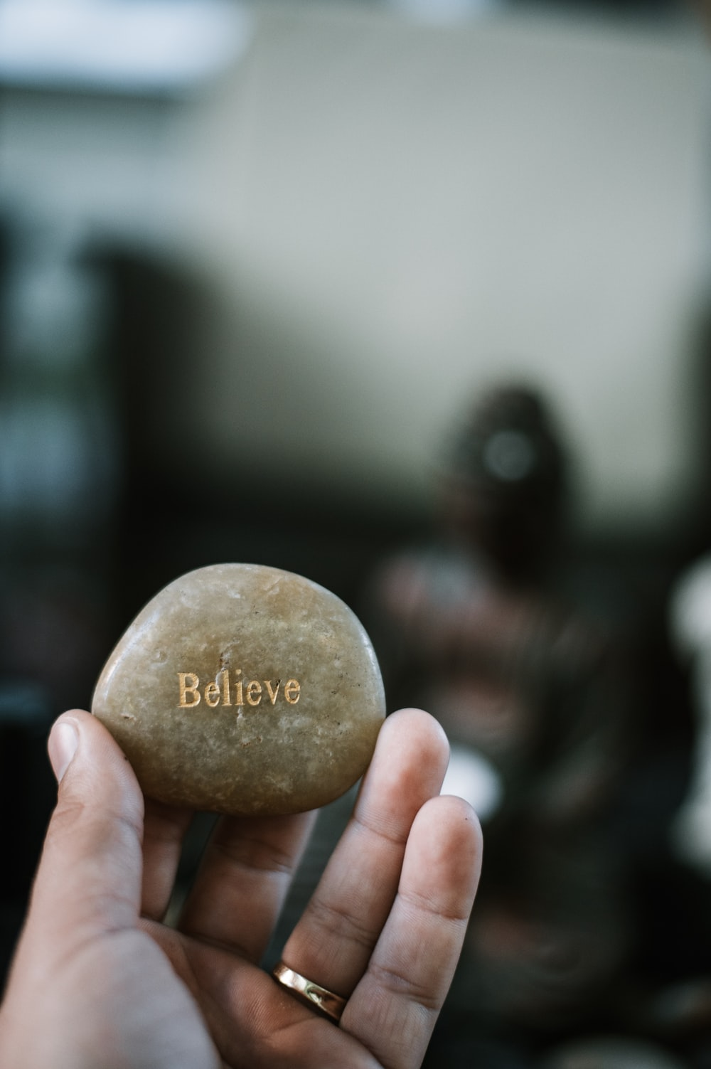
Kids need to know what their parents believe about them.
Notes:
Kids need to know what their parents believe about them: Parents, please listen carefully. Our kids want to know what you think about them. When parents walk into the room, and they are on their phone, they don’t acknowledge their child, they leave the room, just to come back and look in the fridge and they don’t notice their child still sitting at the kitchen counter — doing this send a message to their child that they are not very important. When this type of scenario plays out over and over and over again in your child’s life, it sends the wrong message. You see, a child’s identity is shaped by watching their parents for clues regarding what they believe about him or her. Parents, never forget what I am about to tell you. When you walk into a room where your kids are, within 15 seconds, your kids will be able to tell the kind of day that you have had.

Slide 30
Kids need to know what their parents believe about them.
Notes:
Knowing this, I decided to do something about it. When I get home from work or if I am picking up my kids from school I take a deep breath, and I ask myself the following question: How will my current mood affect my kids? I need to put my bad mood or stress in check for the sake of my kids. The mood I am in, either good or bad, will play a major role in how I respond to my children. As parents, we have all snapped at our kids for doing something that wasn’t a big deal. The reason we snapped at them was because of our current mood or because of the negative and stressful thoughts that we had going through our minds.

Slide 31
Kids need to know what their parents believe about them.
Notes:
When it comes to what we believe about our kids, please don’t just focus on their sports accomplishments, grades, talents, etc. Please don’t misunderstand. These are all important, but your child’s character is what is most important. Teach them patience, integrity, humility, faithfulness, kindness, compassion, and the best way to do it is to live it in front of them. It’s to model this behavior for our kids.

Slide 32
When it comes to parenting, more is caught than taught.
Notes:
When it comes to parenting, more is caught than taught. What if you are parenting a prodigal child? Never stop loving them; never stop praying for them. Yes, we need rules and boundaries in the home, but our kids need to know that their parents love them no matter what. No matter their age, I would encourage you to text or call your child and remind them how much you love them.

Slide 33
Know who your child’s friends are and get to know their parents.
Notes:
Friends – Know who your child’s friends are and get to know who their parents are. Parents, it is our job to teach our children values, not their friends, not the public school and not the media. Teaching them values is our job, mom, and dad. So, let’s lead them, let’s train them, because if we don’t.

Slide 34
…a child left to himself brings shame to his mother. Proverbs 29:15 NKJV
Notes:
The Bible tells us in Proverbs 29:15 “a child left to himself brings shame to his mother.” NKJV

Slide 35
Train up a child in the way he should go, And when he is old, he will not depart from it.
- Proverbs 22:6 NKJV
Notes:
A well-known verse that is often quoted when it comes to raising kids is Proverbs 22:6, which reads, “Train up a child in the way he should go, And when he is old, he will not depart from it.” NKJV.

Slide 36
Notes:
As a parent, you may want your child to grow up in a spiritual bubble as a way to protect them from any godless influence — no TV, no internet, no movies, no music, etc. The truth is, we can’t protect our children from everything. When they are young, we set certain rules for them to follow. A rule is what externally compels our children to obey. But as our children get older, parents should teach their kids to live by principle. A principle has an internal motivation to do what is right. One of the ways that you can accomplish this is by looking for teachable moments where you can demonstrate what it means to live by principle.

Slide 37
Remember, when it comes to parenting, more is caught than taught.
Notes:
Remember, when it comes to parenting, more is caught than taught.

Slide 38
And these words which I command you today shall be in your heart. You shall teach them diligently to your children,
Notes:
Deuteronomy 6:6, 7 tells us, “And these words which I command you today shall be in your heart. You shall teach them diligently to your children,

Slide 39
and shall talk of them when you sit in your house, when you walk by the way, when you lie down, and when you rise. - Deuteronomy 6:6, 7 NKJV
Notes:
and shall talk of them when you sit in your house, when you walk by the way, when you lie down, and when you rise. Deuteronomy 6:6, 7 NKJV

Slide 40
and shall talk of them when you sit in your house, when you walk by the way, when you lie down, and when you rise. - Deuteronomy 6:6, 7 NKJV
Notes:
Moses is telling us to teach your children morning and night. Teach your kids everywhere. I have found some of the greatest spiritual moments with children happen when we are just out doing things. (Speaker Notes: Story of how the cashier gave me back too much change. As I walked out of the store, I was thinking about the change that the cashier just handed me, and the math did not add up. I knew that this was going to be a great teachable moment for my child. I went back to the cashier, and I let them know that they gave me an extra $10. On the way out of the store, I told my child that our family lives by a principle called honesty. Now, share a personal story of a teachable moment that you had with your kids.)

Slide 41
Social Media – Kids need affirmation.
Notes:
Social Media – Kids need affirmation. When it comes to social media, the longer you can keep your child from this, the better. The same goes for allowing our kids to have a smartphone. The longer you wait, the better. All the studies show that kids on social media have higher rates of depression, anxiety, poor body image, and loneliness. According to the report from the Centers for Disease Control and Prevention, the suicide rate among people ages 10 to 24 years old climbed 56% between 2007 and 2017. It is no coincidence that sites like Facebook and Twitter began to take off in popularity in 2006/2007.

Slide 42
Social media and cell phone.
Notes:
Today there are dozens of sites and apps that our kids can use to post updates, pictures and converse with their friends. Studies show that one of the reasons kids go on social media is for affirmation. As parents, we want our kids to have a healthy self-esteem. Social media works against this because kids will check how many likes, clicks, shares, or views their posts received. They post a picture on Instagram so that they can get those hearts. What they are craving is an affirmation. The reason why some teenagers and even tweens will post inappropriate pictures on social media is that they want to feel loved. They want someone to affirm them and say, “You are beautiful.” Social media offers the affirmation that they are not receiving at home.

Slide 43
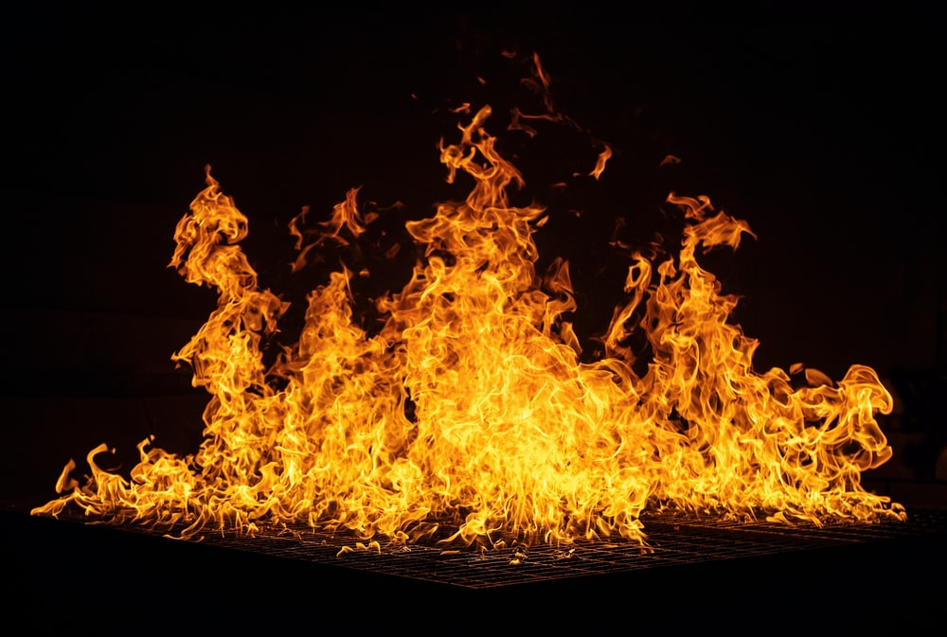
Notes:
If you are a parent who thinks it is OK for your child to have social media accounts, know that you are playing with fire. If you choose to allow this, then please know which sites your kids are on and have access to their accounts. Just know this, you are opening your child up to a world that has very little positive values. Families should have mutually agreed upon social media rules. Parents not only have access to their child’s account, but they also have access to each other’s. No secrets.

Slide 44
Notes:
Engaged Fathers - One of the best things for kids is to have a father engaged in their life. Fathers are critical for helping their kids stay out of trouble. Popular culture has tried very hard to dumb down the role that fathers play in their child’s life. Dads are portrayed as ignorant, sex-crazed, lazy, and uninterested, etc.

Slide 45
Engaged Father
Notes:
Teenagers who have a father in the home are far less likely to struggle with depression, anxiety, and high-risk behavior like sex, drugs, and alcohol. Kids with fathers in the home are more emotionally stable, and they are more likely to finish high school and go on to graduate from college.

Slide 46
Notes:
The culture that our kids are growing up in is hyper-sexualized. We are living during an epidemic of sexually transmitted diseases. This year alone, 20 million people will contract an STD. Even though the teenage population makes up 1/3 of the population in America, yet teenagers will contract ½ of all infections. In the 1970s, there were just a handful of STDs. Today, there are more than 30 different STDs that affect kids who are sexually active.

Slide 47
Notes:
Having fathers connect with their kids will help prevent high-risk behaviors. Dads, I want to talk with you. From the moment your child is born, they don’t care what you look like, how much money you make, the car you drive, the job you have, that child looks at you, and they see one thing — a HERO. If you could see yourself through your child’s eyes, your world would never be the same again. The way your child sees you is dramatically different than the way you see yourself. Fathers are heroes to their children. My question tonight is, dads, are you willing to step into that role?

Slide 48
Kids need parents who are willing to make sacrifices.
Notes:
Kids need parents who are willing to make sacrifices. Remember, you could not pick your parents, but you can choose the kind of parent you will be. To make a sacrifice means you may need to sit across the table from a 16-year-old who has not spoken with you for days and ask them, “How are you doing?” As you listen to them rant and rave, what they need is for someone to listen, to know that they are seen, and that someone cares about them.

Slide 49
Kids need parents who are willing to make sacrifices.
Notes:
I meet parents that are simply paralyzed by the fear that they will no longer be liked or even loved by their children if they chastise them for any reason. They want to be their child’s friend and will sacrifice respect in order to achieve it. Remember, a child will have friends, but only two parents. Every parent needs to learn to tolerate the momentary anger or even hatred directed at them by their children. The idea that I will avoid being the bad guy in order to protect by child from fear or pain does them no good.

Slide 50
Kids need parents who are willing to make sacrifices.
Notes:
Think about it this way. The judgmental and uncaring broader social world will mete out conflict and punishment far greater than that which would have been delivered by an awake parent. As parents you have two options. Either you can discipline your children, or you can turn that responsibility over to the harsh, uncaring judgmental world. In my home, we limit the rules to what is necessary, and we use the least amount of force necessary to enforce those rules.

Slide 51
Kids need parents who will be spiritually strong for them.
Notes:
Kids need parents who will be spiritually strong for them. Get your kids involved in church. Very few things are as powerful in the mind of a child as having family worship.

Slide 52
Kids need parents who will be in the moment with them.
Notes:
Kids need parents who will be in the moment with them. Put down your cell phone and engage your kids. Play a board game, make dinner together, ride bikes, go shopping, or go for a walk. Just be in the moment.

Slide 53
Kids need to know what their parents believe about them.
Notes:
Kids need to know what their parents believe about them. Love them and be the #1 affirmer in their life.

Slide 54
Kids need parents to demonstrate what it means to live a principled life.
Notes:
Kids need parents to demonstrate what it means to live a principled life. Don’t just focus on their performance, but on their character. The best way to teach a child to be patient, kind, compassionate, humble, and have integrity is to live it out in front of them. Remember, more is caught than taught.

Slide 55
Kids need to learn to be responsible.
Notes:
Kids need to learn to be responsible. Teaching kids how to say no and how to accept a no is a gift of enormous value. We have all been around middle-aged adults that throw tantrums when others set limits on them, or they will go along with the crowd to please people. Why is this? It is because, as a child, they were never taught to accept no or how to say no.

Slide 56
Kids need to learn to be responsible.
Notes:
Children need to understand that the world does not revolve around them, and there are times when they need to accept a “no” answer. In the book Boundaries, by Dr. Henry Cloud, he lists the order of progression when it comes to accepting limits or a “no” answer:

Slide 57
1. The NO of parents. 2. The NO of siblings.
Notes:
The no of parents
The no of siblings

Slide 58
3. The NO of school teachers. 4. The NO of school friends.
Notes:
The no of school teachers
The no of school friends

Slide 59
5. The NO of bosses and supervisors. 6. The NO of spouses.
Notes:
The no of bosses and supervisors
The no of spouses

Slide 60
7. The NO of health problems from overeating, alcoholism, or an irresponsible lifestyle. 8. The NO of police, courts, and even prison.
Notes:
The no of health problems from overeating, alcoholism, or an irresponsible lifestyle and The no of police, courts, and even prison.

Slide 61
The goal of parenting is to help our children learn to accept a “no” early in life, hopefully in stage number 1.
Notes:
The goal of parenting is to help our children learn to accept a “no” early in life, hopefully in stage number 1. Sadly, some will have to go all the way to stage eight before they listen to a “no” answer and set limits on their life.

Slide 62
Cease listening to instruction, my son, And you will stray from the words of knowledge. - Proverbs 19:27 NKJV
Notes:
The Bible tells us, “Cease listening to instruction, my son, And you will stray from the words of knowledge.” Proverbs 19:27 NKJV

Slide 63
Kids need to learn the importance of boundaries.
Notes:
Kids need to learn the importance of boundaries. This means kids who learn how to delay gratification and understand the negative results of poor decision making will be better prepared to take on the task of adulthood. For example, if a child chooses to play video games rather than finish their schoolwork, they need to understand that there will be consequences. Inevitability, the teacher will send a note home on Friday, letting the parent know that their child is missing homework assignments. The child will be grounded from playing video games all weekend. By not delaying gratification, the child is learning that there will be negative consequences.

Slide 64
One of the best skills that parents can teach their kids is the skill we call “delay of gratification.”
Notes:
One of the best skills that parents can teach their kids is the skill we call “delay of gratification.” This is the ability to say no to one’s impulses, wishes, and desires to have some gain down the road.

Slide 65
It’s a school of hard knocks for those who leave God’s path, a dead-end street for those who hate God’s rules. - Proverbs 15:10 MSG
Notes:
The Bible tells us in Proverbs 15:10, “It’s a school of hard knocks for those who leave God’s path, a dead-end street for those who hate God’s rules.” This is from the Message paraphrase of the Bible, and I think all of us here can relate to the school of hard knocks. Do not let your child get away with anything that causes you to dislike them. If their actions cause you to dislike them, think what an effect they will have on other people, who care much less about them then you do.

Slide 66
Notes:
Parents, you do not have to be a perfect parent to be a good parent. You are wired with everything you need to be a good parent. The Bible is filled with great instruction, and it helps to be a part of a community of believers. The truth is, we need to encourage each other because parenting is the hardest, but most rewarding job there is. My final advice would be this.

Slide 67
Notes:
Be very intentional about your parenting, don’t be lazy and make sure you are in the moment with your kids. More is caught than taught, so teach them how to live a life of character by demonstrating it in front of them. Pray for your kids, pray for your kids and pray some more.

Slide 68
1. Based on what was just covered, what are some practical things parents can do to build a stronger relationship with the children? 2. What comes to mind when you here the phrase “more is caught that taught?” 3. Describe some qualities of a good parents. 4. Why is it important for parents and their children to be a part of a community?
Notes:
Please be sure to meet in your life groups and go through the discussion questions up on the screen.

